Slide 1
UNIVERSITÀ DEGLI STUDI DI PERUGIA
International Doctoral Program in
Civil and Environmental Engineering
PYTHON FOR NUMERICAL COMPUTING AND DEVELOPMENT OF SCIENTIFIC APPLICATION
Prof. Federico Cluni
A. Y. 2021/22
Lesson #2 – May 6, 2022

Slide 2
Functions
Functions are defined with def:
def raddoppia(x):
"""Double a number.
raddoppia(x)
Function to double the value of a number x.
"""
y = 2*x
return y
The information on the function can be seen with
print(raddoppia.__doc__)

Slide 3
Functions
Several arguments and/or results can be used:
def sommadifferenza(x,y):
"""
sommadifferenza(x,y)
Gives the sum and the difference of numbers x and y.
"""
somma = x + y
differenza = x - y
return somma, differenza

Slide 4
Functions
Default values can be assigned to any of the arguments:
def multiplo(x, N = 2):
"""Multiply a number.
multiplo(x[, N])
Function that, given x, gives Nx.
Default value of N is 2.
"""
y = N*x
return y
Remark
The value of the arguments can be assigned explicitly.
multiplo(3.2, 5)
multiplo(3.2, N = 5)
multiplo( x = 3.2, N = 5)
multiplo( x = 3.2, 5)
NO!

Slide 5
Functions
Advanced mode of argument passing
If the number of arguments is not known in advance:
- the arguments can be grouped in a tuple
def raddoppialista(*lista):
""“Double all the items of a list.
raddoppialista(*lista)
Function to double all the items of a list.
"""
y = []
for x in lista:
y.append( 2*x)
return y

Slide 6
Functions
Advanced mode of argument passing
If the number of arguments is not known in advance:
- the arguments can be grouped in a dictionary
def pubblicazioni(**lista):
"""Research unit publication.
pubblicazioni(**lista)
Function to print the number of pubblications
of each author and return the sum of the pubblications.
"""
N = 0
for autore, numero in lista.items():
print(autore, "ha pubblicato ", numero, "lavori")
N += numero
return N

Slide 7
Functions
Advanced mode of argument passing
If some of the number of arguments are known in advance and some others not:
def funzione(argomenti, *lista1, **lista2):

Slide 8
Functions
Several functions can be defined in the same file, defined module. To import all the functions:
from modulename import *
To import some of the functions
from modulename import funcname1, funcname2
To import some of the functions changing their name
from modulename import funcname as newname
To import all the function in a separate namespace (than the global one):
import modulename
and to use a specific function:
modulename.funcname(…)
Remark
Function are objects, and therefore they can be part of a list
A=[1, 2, raddoppia]
A[2](3.2)

Slide 9
Functions
One particular form of function definition is the lambda forms.
They are small (single command) anonymous (not named) functions:
def potenzasomma(a):
return lambda x, y: (x+y)**a
f = potenzasomma(2)
They can be used with map to apply a function to each element of a list
a=[1,2,3]
b = list(map(lambda x: 2*x, a))
In such cases it may be convenient to use list comprehension:
a = [1, 2, 3]
b = [2*x for x in a]
A = [2, 2, 4]
[x**a for (x,a) in zip(X, A)]

Slide 10
Functions
Another useful function which employ lambda forms is filter whose arguments are a function (returning a boolean value) and a list and return a list with the element for which function is true :
list(filter(lambda x: x % 2 ==0, range(10)))
note the both map and filter return an iterator (as range) but they can be converted to list with
list(iterator)
Remark
Function can return functions!
>>> def creaeq2(a,b,c):
def eq2(x):
return a*x**2+b*x+c
return eq2
>>> f=creaeq2(1,-2,1)
>>> f(2)
1

Slide 11
Functions
When a function is called, remember that a new name to the same object is defined in the local namespace.
test.py
def modifylist(L):
L1 = L
if len(L1)< 3:
pass
else:
L1[1] = 99
return L1
>>> from test import modifiylist
>>> a = [1,2,3]
>>> b = modifylist(a)
>>> print(a+”\n”+b)

Slide 12
Functions
Scopes in Python
Remember that «variables» are names bound to objects.
The same name can be bound to different objects belonging to different namespaces, which can be though as collections of names.
The bult-in namespace is the one defined at the Python start.
When a module is imported, it defines a global namespace for all the function defined in the module itself, however they are called.
When a variable is defined inside a function, it belong to the local namespace.
Please note that the statements executed in the shell, either read from a script file or interactively, are considered part of a module called __main__

Slide 13
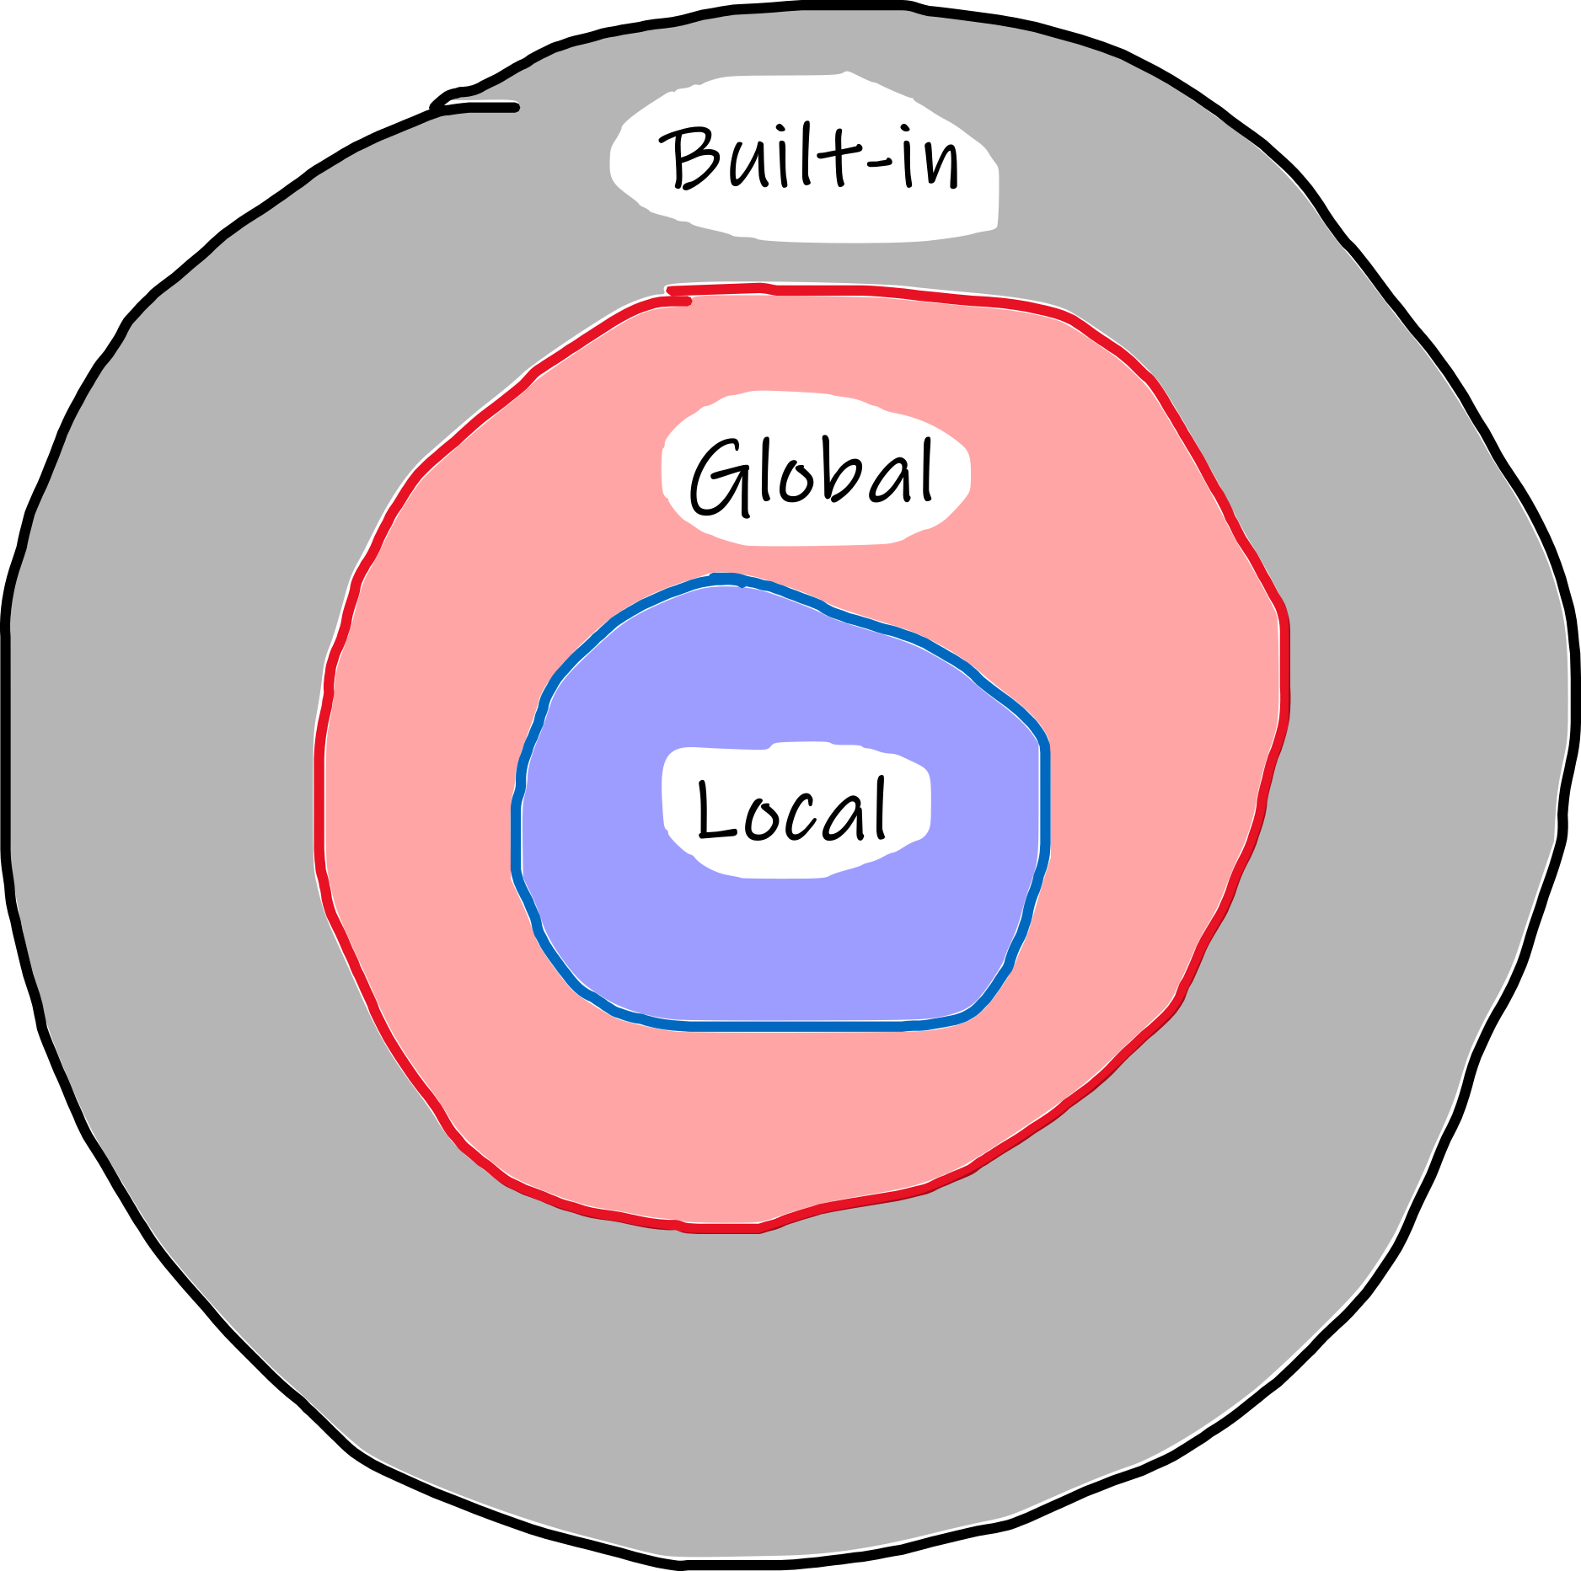
Functions
Scopes in Python
What it is a scope*? It can be though as the portion of a program from where a namespace can be accessed directly, without any prefix.
Tre are at least three nested scopes at any given moment:
Scope of the current function (local)
Scope of the module containing the function (global)
Outermost scope which has built-in names
If a name is not found in the current namespace, it is searched for in the outer namespace, but not in the inner namespace (i.e., a variable defined inside a function can not be accessed from outside the function).
If a function want to change a variable in the global namespace, that variable has to be defined as global.
See the official guide to learn more
https://docs.python.org/3/tutorial/classes.html#python-scopes-and-namespaces
* comes from Ancient Greek: σκοπεῖν, skopeîn, "to look" or "see"
Notes:
see also: https://www.programiz.com/python-programming/namespace

Slide 14
Functions
Since the namespaces are kept separate, different variable with the same name can be used since they are bound to object in different scope.
test_scope.py
a = 3
def multiple(x):
return a*x
>>> from test_scope import multiple
>>> a = 4
>>> multiple(3)
9

Slide 15
Base functionality
To list the content of a module
dir(ModuleName)
To write to a file:
fw = open("file.txt", "w")
fw.write("{:s} \t {:d} \t {:8.2f} \t {:12.4e} \n".format("A", 12, 894.9765, 123456.3) )
# fw.write("%s \t %i \t %8.2f \t %12.4e \n" % ("A", 12, 894.9765, 123456.3) )
fw.close()
To read from a file:
fr = open("file.txt", "r")
fr.readline() # read a single line
fr.readlines() # read all the lines and put them in a list
fr.close()

Slide 16
Base functionality
Beside the slicing that works on the strings as works on the lists, there are some string operation that can be useful.
- To delete spaces and tabulations at the beginning and the end of the string:
" sono una stringa \n".strip()
- To divide a string where a space/tabulation is found:
"dato1 dato2 dato3".split(" ")
"dato1\tdato2\tdato3".split("\t")
- To join several strings:
"/".join(["23", "4", "2010"])
"23" + "/" + "4" + "/" + "2010"
- To repeat a string:
5*"spam"
- To replace some portion of the string with another string
"Non mi piace il corso".replace("Non mi piace", "Mi piace molto")

Slide 17
Some fundamental modules
Module pickle
The module convert objects into stream of byte that can be saved to a file and then be recovered.
- to pickle (save)
import pickle
fw = open(filename,'wb')
pickle.dump(oggetto1, fw)
pickle.dump(oggetto2, fw)
fw.close()
- to unpickle (load)
import pickle
fr = open(filename,'rb')
oggetto1 = pickle.load(fr)
oggetto2 = pickle.load(fr)
fr.close()
N.B the object are loaded in the same order as they are saved

Slide 18
Some fundamental modules
Modulo shelve
The object can also be saved in a file which act as a dictionary.
- to save
import shelve
fw = shelve.open(filename)
fw[ key ] = Object
fw.close()
- to load
import shelve
fr = shelve.open(filename)
Object = fr[ key ]
fr.close()
WARNING!
Both with pickle and shelve, it is insecure to load from an untrusted source since it could be possible to execute arbitrary code.

Slide 19
Some fundamental modules
Module os
Allows the interaction with the operating system
import os
os.getcwd()
os.chdir(NewDirectory)
os.listdir(Directory)
Module shutil
Allows a high-level operativity on files.
import shutil
shutil.copy(Source,Destination/DestinationDirectory)
shutil.move(filename, Directory)
Notes:
See also here: Python OS and Shutil Modules. The OS module in Python provides… | by TechFitLab | Techfitlab | Medium

Slide 20
Some fundamental modules
Module glob
Allow to search for files and directory
import glob
glob.glob('*.pdf')
Module sys
To interact with OS shell
import sys
- to pass values to arguments through command line: a list is generated named sys.argv, the first element (index 0!) is the name of the script!
- to add temporarily a directory in the environment variable where Python look for the modules
sys.path.append(Directory)

Slide 21
Some fundamental modules
Module math
Frequently used math operators.
acos
asin
atan
atan2
ceil
cos
cosh
degrees
e
exp
floor
hypot
log
log10
pi
pow
radians
sin
sinh
sqrt
tan
tanh
Module random
To work with (pseudo) random numbers.
betavariate
choice
expovariate
gammavariate
gauss
getrandbits
lognormvariate
normalvariate
paretovariate
random
sample
seed
shuffle
uniform
vonmisesvariate
weibullvariate
Module decimal
Allows an exact representation of real numbers. It also implement significant places evaluation and it is possible to define an arbitrary precision .

